Slide 1
Volatility Modeling Generalized Auto Regressive Conditional Heteroscedasticity (GARCH) Models
Kakali Kanjilal
Professor, Operations
IMI, Delhi

Slide 2
Daily SENSEX
Non-stationary Series
Residual Series of ARIMA (1,0,0) SARIMA(0,1,1^{)5:} estimated by OLS.
Low volatility
This suggests residuals are not constant over time. In fact, it is highly volatile over the time. But volatility pattern is different at different points in time.
Stationary but Volatile Series
High volatility

Slide 3
Daily Oil Price
Non-stationary Series
Residual series of ARIMA(1,0,1) SARIMA(1,1,1)⁵
High volatility period
This suggests residuals are highly volatile towards the end, but less volatile in the middle and beginning of the sample.
Stationary Series

Slide 4
Daily Exchange Rate
Non-stationary Series
Residual series of ARIMA(1,0,0) SARIMA(0,1,1)⁵
This suggests residuals are volatile in the middle and end of the sample. But volatility towards the end is higher than the middle.
High Volatile Period

Slide 5
Monthly Peak Gold Price
Non-stationary Series
Residual series of ARIMA(1,0,1) SARIMA(1,1,1)¹²
Seems…there is variability, but variability is constant over the sample?
This suggests variability in residuals is constant over the sample period unlike ARIMA models of ‘SENSEX’, OIL PRICE’ and EXCHANGE RATE’ series.

Slide 6
What do we observe?
Residuals of MSARIMA models of SENSEX returns, Oil price changes and Exchange Rate changes are volatile series.
Volatility changes over time or over the sample. At some points in time, it is highly volatile, but at some points it is less volatile and at some points it is not volatile at all.
So, it seems residual volatility/variability has a pattern. For example, high volatile period follows high volatility and remains so for sometime. Similar is the case with low volatile period.
Residual series of ARIMA model of Gold Price changes seems to be constant over time.

Slide 7
Some Obvious Questions…
Graphically it seems variability in residual series shows a pattern, but it is indicative.
How can we confirm it? Is there any statistical test which confirms that the variability in residual series is not constant?
If the residual series of ARIMA models exhibit some pattern, is the ARIMA model forecast accurate?
If not, what should be done to correct it?

Slide 8
What ARIMA Model does…
GARCH family of models estimate and predict both mean and risk return for
those time series data where volatility changes over time and follows a pattern.
How is it modelled? Like AR models, GARCH family models volatility as a function of its past having different weights. But how should we decide -how far in the past the model should delve into ? Just a few periods in the past or long periods?
In other words, risk return should be modelled as a short memory or long memory process?
ARIMA/SARIMA estimates conditional mean.
This means it estimates and predicts on average what would be the sensex return or oil price return or exchange rate return in future assuming that the variation in residual or prediction error is constant.
So, it predicts mean return without taking into account the risk or variability or volatility that mean return might face in future.
Hence, along with the prediction of mean return, prediction of variability or risk in return is essential to forecast the future return accurately.

Slide 9
Problem with ARIMA Modeling
SENSEX returns and Oil price changes are stationary but volatile series.
Univariate ARIMA modelling to forecast the daily ‘SENSEX returns’ OR ‘Oil Price changes’ using OLS estimation will predict the ‘conditional mean’ of these series based on past information with the assumption that the residual variance is constant over time.
But these series exhibit high variability suggesting that conclusion/forecast based on OLS is likely to be inaccurate, hence a correction is required to reduce this variability or volatility or risk or heteroscedastic error variance.

Slide 10
Need for Volatility Modeling
The basic version of least squares model assumes that the expected value of all error terms, when squared, is same at any given point. The variances of error term is constant. Known as “HOMOSCEDASTIC” assumption.
This assumption often gets violated in energy and financial time series data where the variance of error terms are larger at some points than for others. It exhibits periods of high volatility followed by low volatility ----implying that the data suffers from heteroscedaticity.

Slide 11
Need for Volatility Modeling
For such data, large and small errors tend to occur in clusters, i.e., large returns are followed by more large returns, and small returns by more small returns in financial markets.
Hence, some time periods are riskier than others; that is, the expected value of the magnitude of error terms at some periods is greater than at others.

Slide 12
Need for Volatility Modeling
Moreover, these risky times are not scattered randomly across quarterly or annual data. Instead, there is a degree of autocorrelation in the riskiness of financial returns. Here, volatility/variability/risk is autocorrelated/systematic!
Instead of correcting this problem and re-estimating the conditional mean, the ARCH and GARCH models address the issue of heteroscedasticity by modelling the heteroscedastic variance which changes over time.

Slide 13
Volatility Models
The goal of such models is to provide a volatility measure—like a standard deviation—that can be used in financial decisions concerning risk analysis, portfolio selection and derivative pricing.
GARCH family models deal with such non-linear time-series which model the mean (Expected Return) and Risk (Variance) conditional on the past information & then forecast

Slide 14
Volatility Models
Let the dependent variable be labeled r_{t}, the return on an asset or portfolio. The mean value m_{t} and the variance h_{t} will be defined relative to a past information set.
So,
r_{t} = E (r_{t} / r_{t-1,} r_{t-2,} … r_{t-s}) + u_{t}
= E (r_{t} / r_{t-1,} r_{t-2,} … r_{t-s}) + SE (r_{t} / r_{t-1,} r_{t-2,} …, r_{t-s}) * Ԑ_{t} ;
= m_{t} + h_{t}^{1/2} Ԑ_{t} ;
where Ԑ_{t} is the error term for the present period,
hence white noise with mean zero and constant variance

Slide 15
Volatility Models
The econometric challenge is to specify how the information is used to forecast the mean and variance of the return, conditional on the past information
While many specifications have been considered for the ‘mean return’ and have been used in efforts to forecast future returns, virtually no methods were available to model and forecast ‘variance return’ before the introduction of ARCH models
The primary descriptive tool was the rolling standard deviation. This is the standard deviation calculated using a fixed number of the most recent observations.

Slide 16
Volatility Models
For example, this could be calculated every day using the most recent month (22 business days) of data
It is convenient to think of this formulation as the first ARCH model; it assumes that the variance of tomorrow’s return is an equally weighted average of the squared residuals from the last 22 days
The assumption of equal weights seems unattractive, as one would think that the more recent events would be more relevant and therefore should have higher weights
Furthermore the assumption of zero weights for observations more than one month old is also unattractive.

Slide 17
ARCH Models
ARCH model proposed by Engle (1982) let these weights be ‘parameters’ of changing variance to be estimated.
The model allowed the data to determine the best weights to use in forecasting the variance.
ARCH models are employed commonly in modeling financial time series that exhibit time-varying volatility clustering, i.e. periods of swings followed by periods of relative calm.

Slide 18
ARCH Models
Consider a regression or auto-regression model;
y_{t} = α + βx_{t} + u_{t} ; OR y_{t} = βy_{t-1} + u_{t} ;
where u_{t} ~ N(0, σ²) and σ² is not constant but changes over time and dependent on the past history.
So,
where ε_{t} is white noise and follows standard normal with mean zero and variance unity and h_{t} is the systematic variance which changes over time, a scaling factor.

Slide 19
ARCH Models
Engel (1982) proposed a model where volatility in the
current period is a function of volatility in the previous periods.
h_{t} = σ_{t}² = γ₀ + γ₁ u²_{t-1} ; is called an ARCH (1) process.
So, when a big shock happens in previous period (t-1), it is more likely that the value of u_{t-1} (because of squares) will be bigger as well and hence the shock will be large in current period also if γ₁ is positive.

Slide 20
ARCH Models
Similarly, ARCH(2) process can be expressed as
h_{t} = γ₀ + γ₁ u²_{t-1} + γ₂ u²_{t-2}
ARCH(q) process will be
h_{t} = γ₀ + γ₁ u²_{t-1} + γ₂ u²_{t-2} …..+ γ_{q} u²_{t-q} + w_{t} ;
where w_{t} is a new white noise process with mean zero and constant variance.
As h_{t} cannot be negative, the ARCH(q) model valid provided γ₀ > 0 and γ_{j} >= 0 for j = 1, 2, …, q . Also, for stationarity conditions, ∑ γ_{j} < 1; j = 1, 2, …, q

Slide 21
Estimation Steps
Step 1: The underlying variable/s should be stationary
Step 2 : Estimate the regression or auto-regression model with OLS and obtain its residuals.
Step 3: Test for the presence of heteroscedasticity in residual variance known as “Test of ARCH Effect”
Step 4: If the ARCH effect is present, estimate an ARCH model of appropriate lag (q) based on AIC/SBC criteria.
ARCH model is estimated with Maximum Likelihood Estimator.

Slide 22


Estimation Steps
AR(q)-ARCH(q) Model
Estimate the best fitting AR(q) model . So, the
assumption is …process needs to be stationary.
Obtain the squares of the error ε_{t} ² and regress them on a
Constant and q lagged values: where q is the length of
ARCH lags.
under the null hypothesis that conditional
Heteroscedasticity or ARCH disturbance effect is present.

Slide 23
Estimation Steps
(y_{t} = βx_{t} + u_{t})- AR(1)-ARCH (q) Model
Estimate the model by OLS (y_{t} = βx_{t} + ε_{t}) with one autoregressive lagged term.
Obtain the squared error term ε_{t} ² and regress ε_{t} ² on a constant and q lagged values: where q is the length of ARCH lags.
under the null hypothesis that conditional heteroscedasticity or ARCH disturbance effect is present.
is present.

Slide 24
ARCH Effect Test
Obtain the squared error term ε_{t} ² (obtained from regression or auto-regression model) and regress ε_{t} ² on a constant and q lagged values: where q is the length of ARCH lags.
Test there is no autocorrelation in error variance, that is, H₀ : α₁ = α₂ = …= α_{q} = 0 against
H₁ : α₁ ≠ α₂ ≠ … ≠ α_{q} ≠ 0,
This can be tested by both F-statistic and Chi Square Statistic = nR² . If accepted, then Var (ε_{t} ² ) = α₀ implying that there is no ARCH effect.

Slide 25
Important Notes
In the absence of ARCH components, ARCH (q) = AR(q)
ARCH model is more of a moving average specification than a autoregression!!
Do not confuse with autocorrelation of the error term with ARCH model. In ARCH model, it is the variance of error term that depends on the previous error term.
The presence of ARCH effect does not invalidate the OLS estimates, but leads to invalid hypothesis testing.

Slide 26
Problems of ARCH Models
The intuition behind the ARCH(1) model is that short-run conditional variance/volatility of the series is a function of the immediate past values of the squared error term
ARCH (q) is an extension of ARCH(1) model, and useful when volatility of the series is expected to change more slowly than in ARCH(1) model. Works best when volatility is a short-memory process!!
In case of a long memory process, ARCH(q) models are difficult to estimate!!

Slide 27
GARCH Models
A useful generalization of ARCH model is the GARCH parameterization introduced by Bollerslev (1986)
This model is also a weighted average of past squared residuals, but it has declining weights that never go completely to zero
It gives parsimonious models that are easy to estimate and, even in its simplest form, has proven surprisingly successful in predicting conditional variances

Slide 28
GARCH Models
The most widely used GARCH specification asserts that the best predictor of the variance in the next period is a weighted average of the long-run average variance, the variance predicted for this period, and the new information in this period that is captured by the most recent squared residual
Consider the trader who knows that the long-run average daily standard deviation of the Standard & Poor’s 500 is 1 percent that the forecast he made yesterday was 2 percent and the unexpected return observed today is 3 percent.

Slide 29
GARCH Models
Obviously, this is a high volatility period, and today is especially volatile, which suggests that the forecast for tomorrow could be even higher
However, the fact that the long-term average is only 1 percent might lead the forecaster to lower the forecast
The best strategy depends upon the dependence between days

Slide 30
GARCH Models
If these three numbers are each squared and weighted equally, then the new forecast would be
However, rather than weighting these equally, it is generally found for daily data that weights such as those in the empirical example of
(.02, .9, .08) are much more accurate
Hence the forecast is

Slide 31
GARCH (p,q) Models
This model GARCH (p, q) estimates conditional variance as a function of ‘weighted average of the past squared residuals’ till q lagged term, and ‘lagged conditional variance’ till p terms.
The basic ARCH (q) model is a short memory process in that only the most recent q squared residuals are used to estimate the changing variance. The GARCH model allows long memory processes, which use all the past squared residuals to estimate the current variance.

Slide 32
GARCH (p,q) Models
Consider a regression or auto-regression model;
y_{t} = α + βx_{t} + u_{t} ; OR y_{t} = βy_{t-1} + u_{t} ;
where u_{t} ~ N(0, σ²) and σ² is not constant but changes over
time and dependent on the past history.
where ε_{t} is white noise and ~N(0,1) ;
h_{t} is the systematic variance which changes over time, a scaling factor.
The GARCH (1,1) model can be written as

Slide 33
GARCH (p,q) Models
The GARCH (p,q) model can be written as
So, h_{t} now depends both on past values of the shocks/error, which are captured by the lagged squared residual terms, and on past values of itself, which is captured by lagged h_{t} terms. This is called Variance Equation.
γ₀ >0, δ_{i} > 0, γ_{j} > 0; non-negativity conditions.
and δ_{i} + γ_{j} < 1
Mean Equation is :
y_{t} = α + βx_{t} + u_{t} ; OR y_{t} = βy_{t-1} + u_{t} ;

Slide 34
GARCH (p,q) Models
The GARCH (1,1) model can be expressed as an infinite
ARCH (q) process.
GARCH(1,1) Model:
GARCH (1,1) model is equivalent to an infinite order ARCH model
with geometrically declining coefficients. This means GARCH (1,1)
model is an alternative to higher order ARCH model, where less
parameters are required to be estimated.

Slide 35
GARCH (p,q) Models
The GARCH (p,q) model
can be expressed as an ARMA (m,p) process in u_{t}² where m = max{p,q} as follows:
The above expression is meaningful but difficult to deal with in practice.

Slide 36
GARCH-M (p,q) Models
Y_{t} = α + βX_{t} + θh_{t} + u_{t} ; where u_{t} ~ iid N(0,h_{t})
GARCH in mean or GARCH-M models are those where conditional variance is a regressor in conditional mean equation
Risk-averse investors requires a premium to hold a risky asset. Risky assets should have higher premium, higher the risk , higher the premium. So, return is a function of risk.
GARCH-M models can be linked with CAPM models

Slide 37
Problem of ARCH/GARCH
A major restriction of ARCH/GARCH model is the fact that these models provide symmetric estimates of volatility/shocks as residuals are squared term.
But, in practice, financial markets react differently in response to “Good News” and “Bad News”.
Negative shocks (“Bad News”) bring larger impact on volatility in returns/financial series compared to positive shocks (“Good News”) having same magnitude
For many stocks, there is a strong negative correlation between the current return and the future volatility.

Slide 38
Problem of ARCH/GARCH
The tendency for volatility to decline when returns rise and to rise when returns fall is often known as ‘Leverage Effect’.
These issues are handled by T-GARCH (Threshold), GJR-GARCH and E-GARCH (Exponential) models

Slide 39
TGARCH (p,q) Models
The threshold GARCH or TGARCH model was introduced by Zakoian (1990) and Glosten, Jaganathan and Runkle (GJR-GARCH) (1993)
A TGARCH (1,1) is given by :
where d_{t-1} = 1; if u_{t-1} < 0 Negative Shock
= 0; if u_{t-1} >= 0 Positive Shock
is a multiplicative dummy variable to check whether there is statistically significant difference when shocks are negative vs positive.

Slide 40
TGARCH (p,q) Models
So, when u_{t-1} >=0 then the effect of u_{t-1} on h_{t} is γ₁ .
When u_{t-1} < 0, then the effect of u_{t-1} on h_{t} is (γ₁ + λ₁ ).
If λ₁ > 0, we conclude that there is asymmetry, otherwise when λ₁ = 0, the news impact is symmetric.
So, impact of ‘good-news’ and ‘bad-news’ is different. ‘Bad-news’ has larger effect on volatility of the series than the good news.
A TGARCH (p,q) model can be written as :

Slide 41
EGARCH (p,q) Models
Exponential GARCH or EGARCH model was developed by Nelson (1991) can be written as
Since the left hand side of the equation is log of h_{t} , so, the variance itself will be positive irrespective of whether the coefficients are positive or not.
So, as opposed to the GARCH model, no restrictions of non-negativity need to be imposed on for the estimation.

Slide 42
EGARCH (p,q) Models
EGARCH (p,q) models can be written as
γ₀ : the mean of the volatility equation
λ : represents the size effect, which indicates how much volatility increases irrespective of the direction of the shock
γ : represents the sign effect, which examine whether shocks have asymmetric or symmetric effects on volatility. When γ < 0, a positive shock u_{t-j} >= 0 (good-news) generates less volatility than a negative shock (bad-news) u_{t-j} < 0.
δ : represents an evaluation of the persistence of shocks. Nelson shows that absolute value of ‌‌‌‌‌‌‌‌ δ ‌‌‌ <1 ensures stationarity.

Slide 43
EGARCH (p,q) Models
EGARCH (p,q) models can be written as
A number of researchers have found that evidence of asymmetry in stock price behaviour-negative surprises seem to increase volatility more than positive surprises.
Since a lower stock price reduces the value of equity relative to corporate debt, a sharp decline in stock prices increases corporate leverage and could thus increase the risk of holding stocks. So, γ < 0 is sometimes described as ‘leverage effect’

Slide 44
I-GARCH (p, q) Models
In financial time series, the conditional volatility is persistent. For a long time series model, if one estimates GARCH (1,1) model, it will be found that the sum of γ₁ + δ₁ is very close to unity.
This constraint forces the conditional variance to act like a process with unit root.
One of the limitations of GARCH (p,q) models is it assumes that the process is stationary. I-GARCH or Integrated GARCH overcomes this.

Slide 45
I-GARCH (p, q) Models
A GARCH (p,q) process is stationary with a finite variance if
A GARCH (p, q) process is I-GARCH or non-stationary GARCH (p,q) if

Slide 46
I-GARCH (p, q) Models
I-GARCH processes are either non-stationary or if they are stationary they have infinite variance. Infinite variance means heavy tails! A distribution can be heavy-tailed with a finite variance.
A GARCH (1,1) model can be expressed as :
so, unlike a true non-stationary process, the conditional variance h_{t} is a geometrically decaying function of the current and past realizations of u_{t-j}² . Hence, an I-GARCH model can be estimated like any other GARCH model.

Slide 47
How to fit an MSARIMA+GARCH in R?

Slide 48
First fit an Arima model and then fit a GARCH model to the errors. The prediction of the Arima model will not depend on the GARCH error – but confidence intervals however will.

Slide 49
Efficient estimators of the conditional mean model (the ARIMA part) depend on the conditional variance model (the GARCH part). Using efficient estimators would mean that the forecasts of ARIMA will be different depending on whether GARCH is included or not. While you can take estimators that do not have this property, they will generally be statistically inferior (less efficient). But they will be computationally simpler, of course.

Slide 50
SARIMA-GARCH is not currently implemented in R One can deal with seasonality by including some dummy variables or Fourier terms in the conditional mean model. If you are using the "rugarch" package in R, you can include these terms via the argument external.regressors within the argument mean.model in the ugarchspec function.

Slide 51
Volatility Modelling CASES

Slide 52
Estimation Steps
Check the stationarity of variables
If non-stationary, make the variables stationary
Run the regression or auto-regression with stationary variables.
Check if the residual has become random by Q-statistic
Check if ARCH effect is present
If yes, estimate ARCH models with appropriate lags.

Slide 53
Estimation Steps
7. If lag order(<3) is significant ARCH is appropriate. If lags of higher order is significant, GARCH family of models are more appropriate.
8. Check the ARCH-LM test of residuals of ARCH or GARCH models. If accepted, variance of residual has become random or homoscedastic.

Slide 54
ARCH Model CASES

Slide 55
CASE Modeling and forecasting of day-ahead electricity price in Indian Energy Exchange

Slide 56
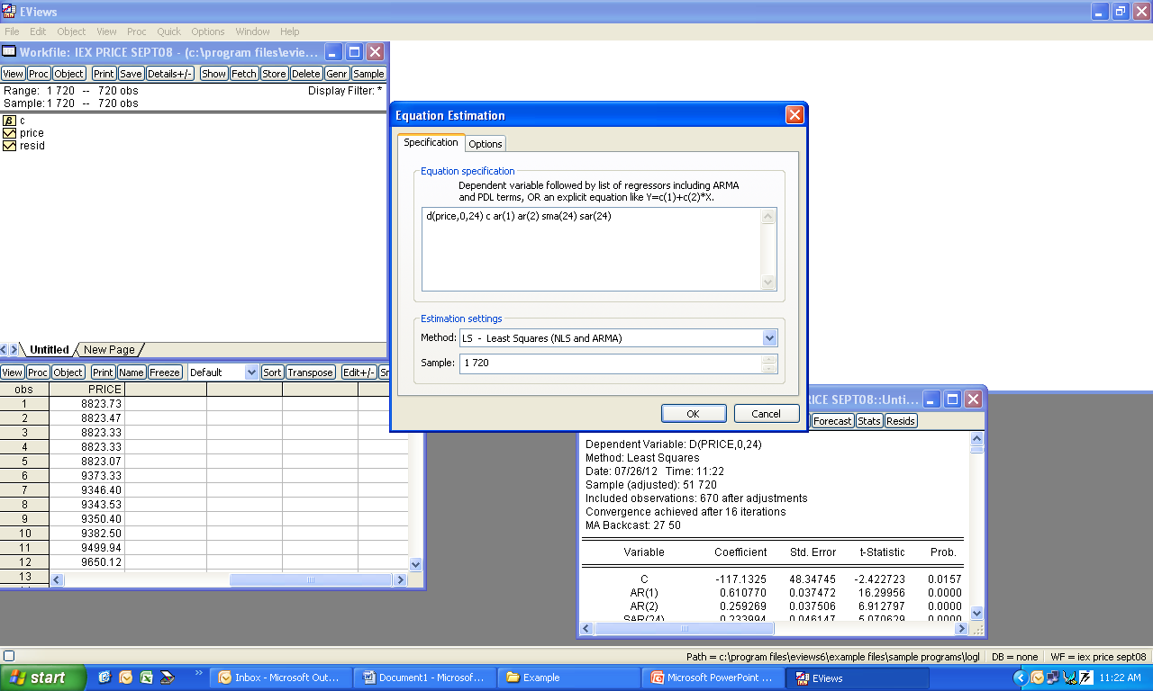
ARIMA (1,0,0) SARIMA(1,1,1)²⁴

Slide 57
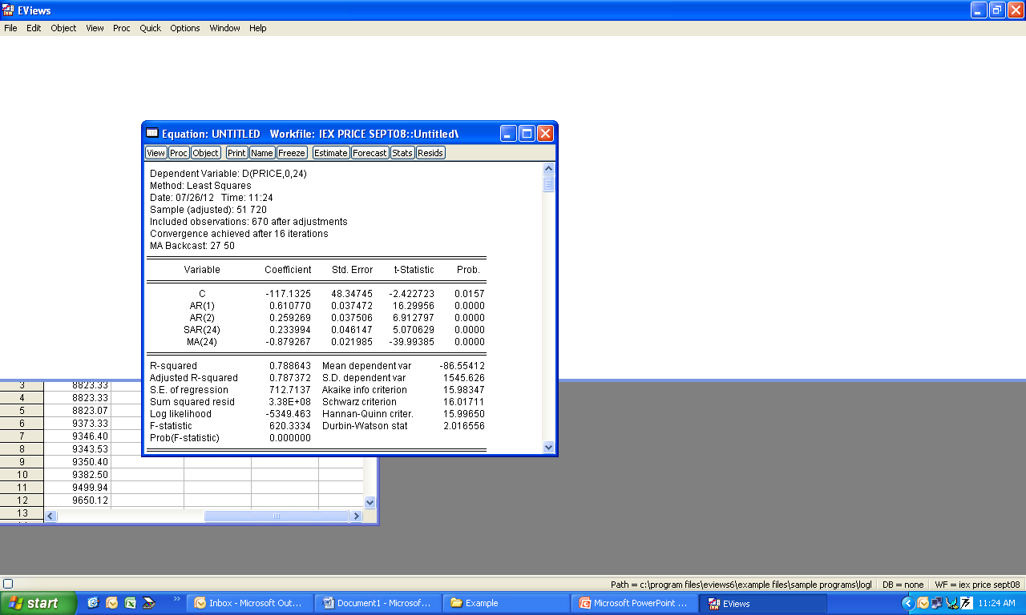
MSARIMA model ARIMA (1,0,0) SARIMA(1,1,1)²⁴
is estimated.

Slide 58
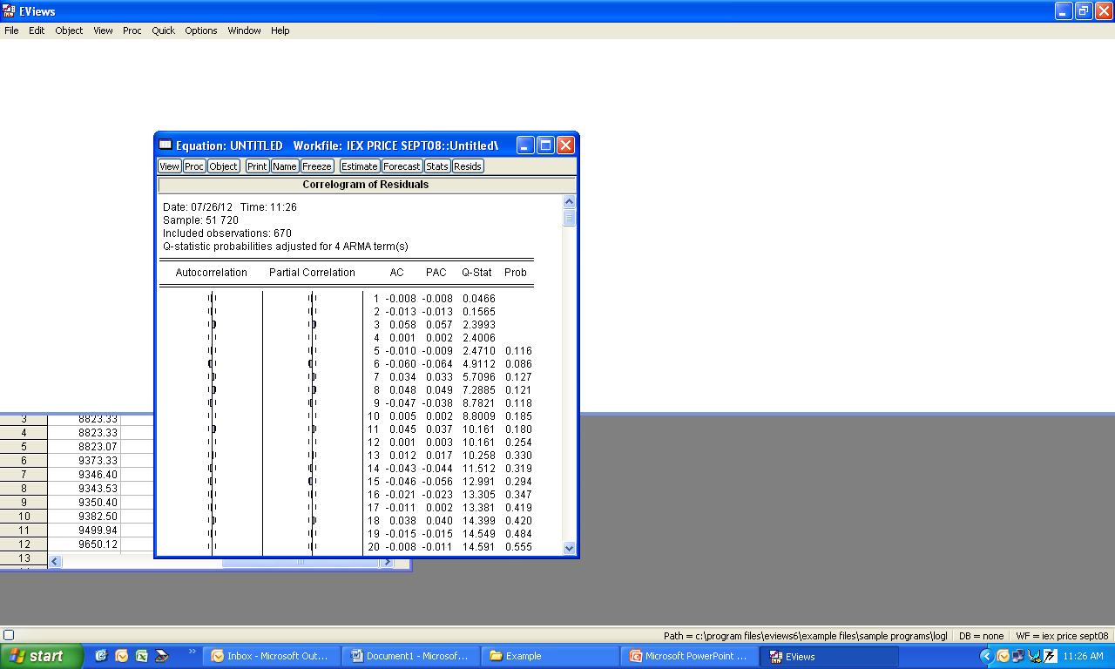
Residual has become random

Slide 59

Squared Residual is not random

Slide 60
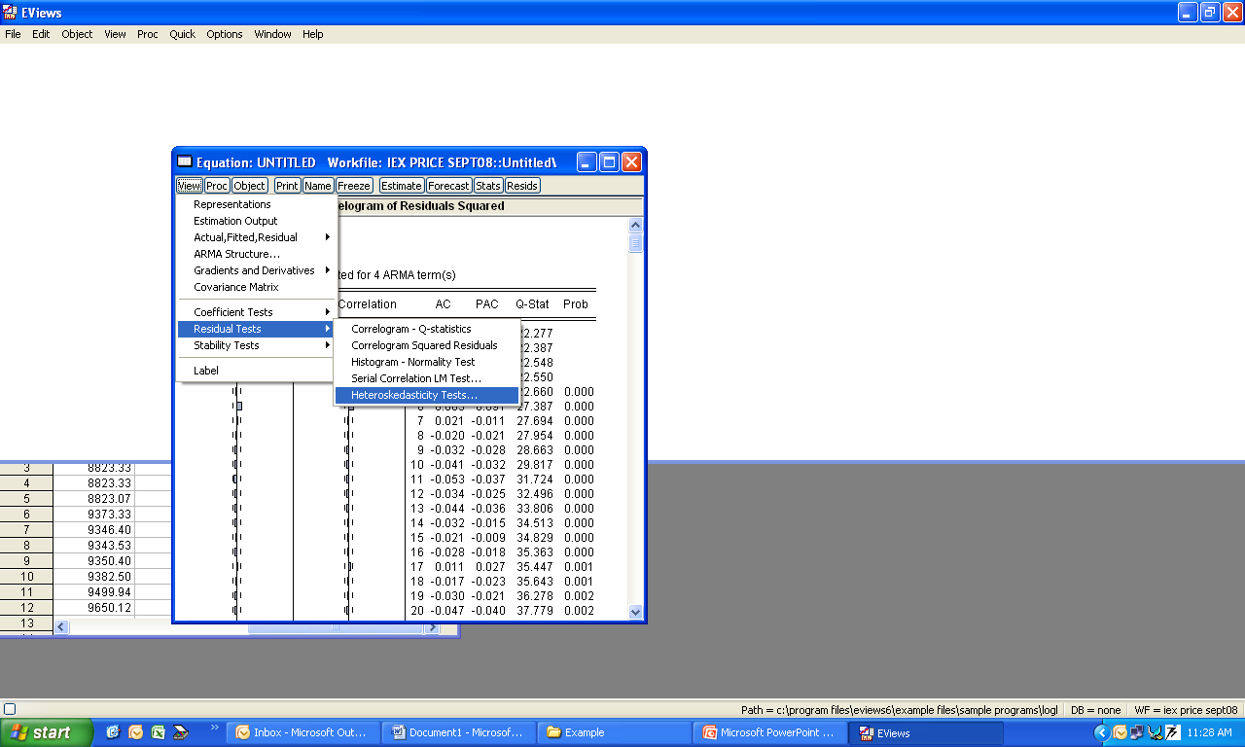
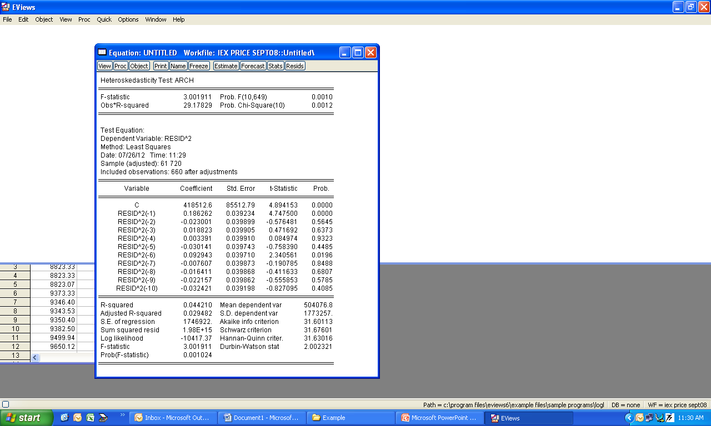
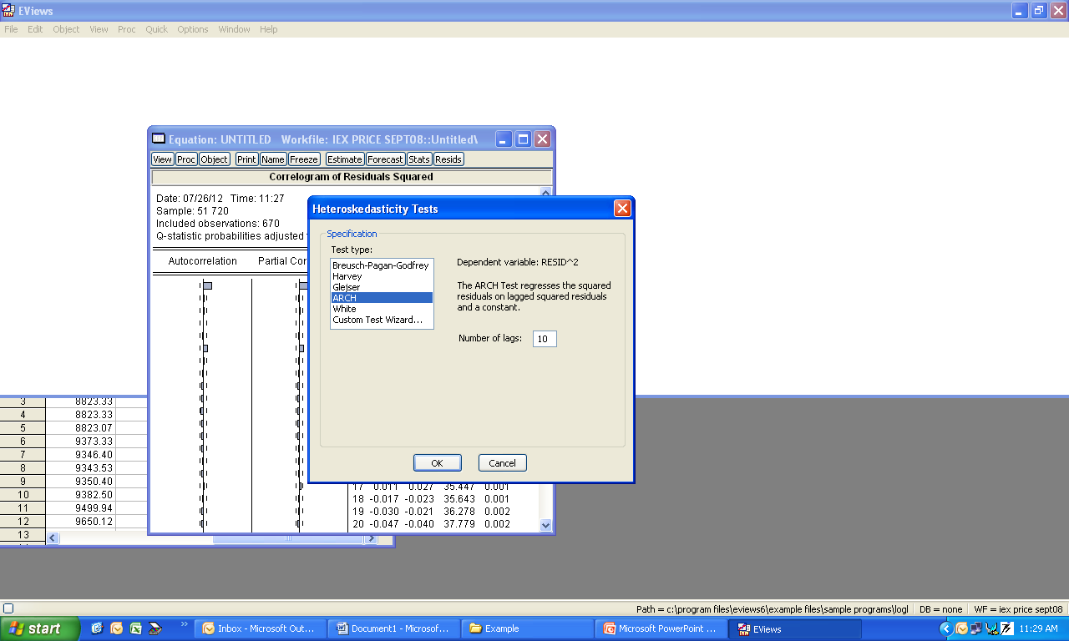
ARCH- Test
Select ARCH test & lag 10
Hypothesis: there is no ARCH effect or the
Variance of error is not heteroscedastic.
Rejects Hypthesis: implies ARCH effect is present .

Slide 61
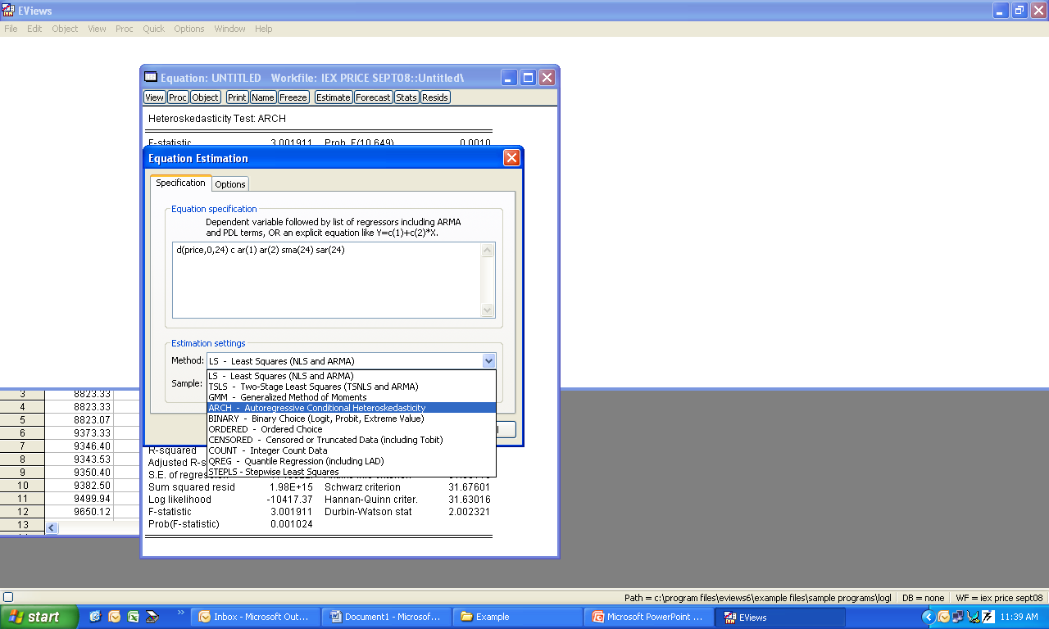
Select ARCH Estimation

Slide 62
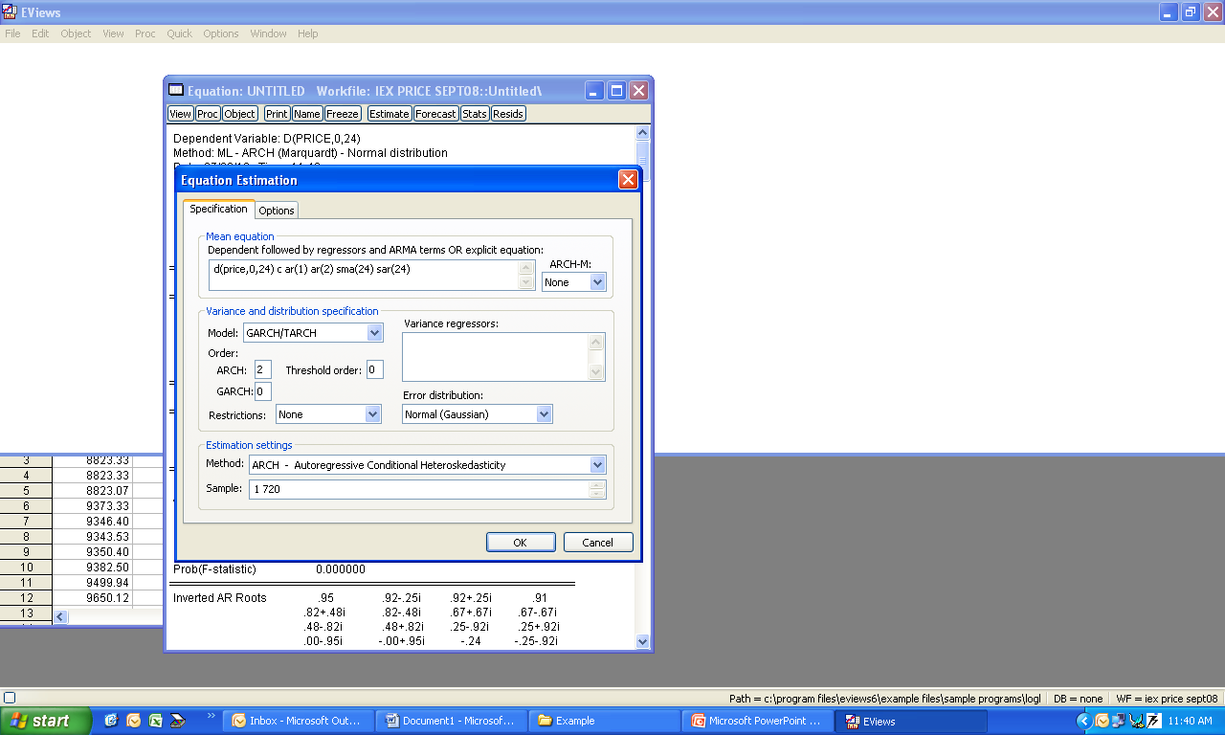
Mean equation is same as ARIMA part
In variance equation, select ARCH order 2 and make GARCH order 0

Slide 63
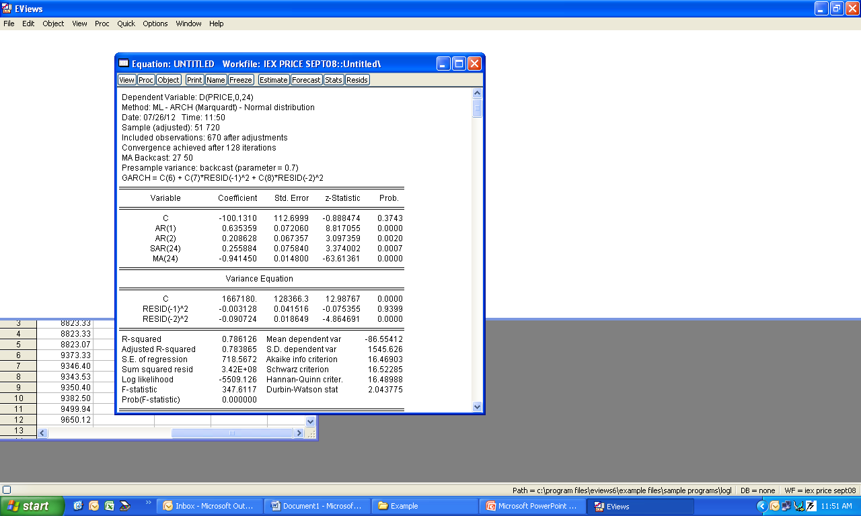
ARCH parameters are not significant, so some of them could be redundant.
Also, parameters are negative. So, run ARCH(1).

Slide 64

ARCH(1) is significant, positive and less than 1.
AIC has improved.
Forecast should also improve.

Slide 65
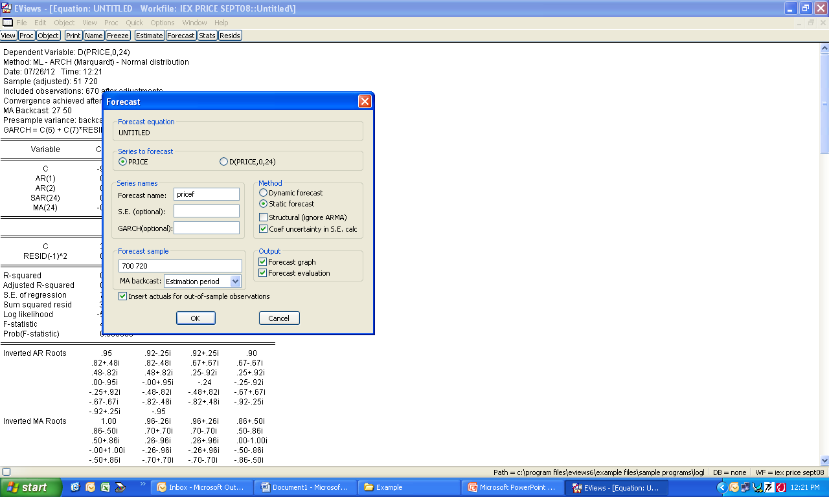
FORECAST PRICE

Slide 66
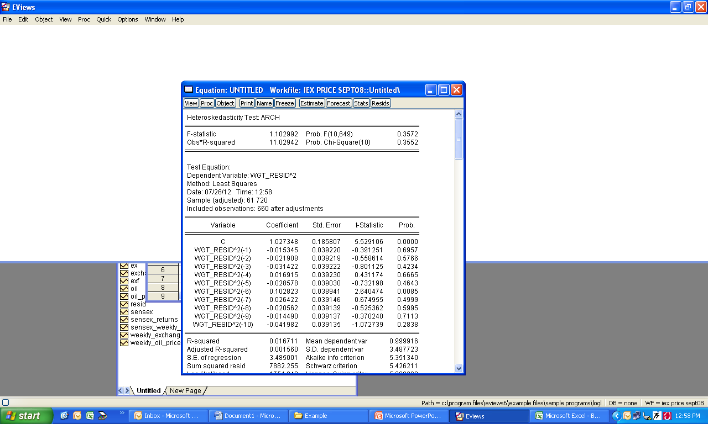
Variance of error is no more heteroscedastic
Forecast by ARIMA (1,0,0) SARIMA(1,1,1)²⁴ ARCH(1)
Forecast by ARIMA (1,0,0) SARIMA(1,1,1)²⁴
MAPE has improved marginally., by 10 basis point.

Slide 67
CASE Modeling and forecasting of day-ahead Exchange Rate

Slide 68
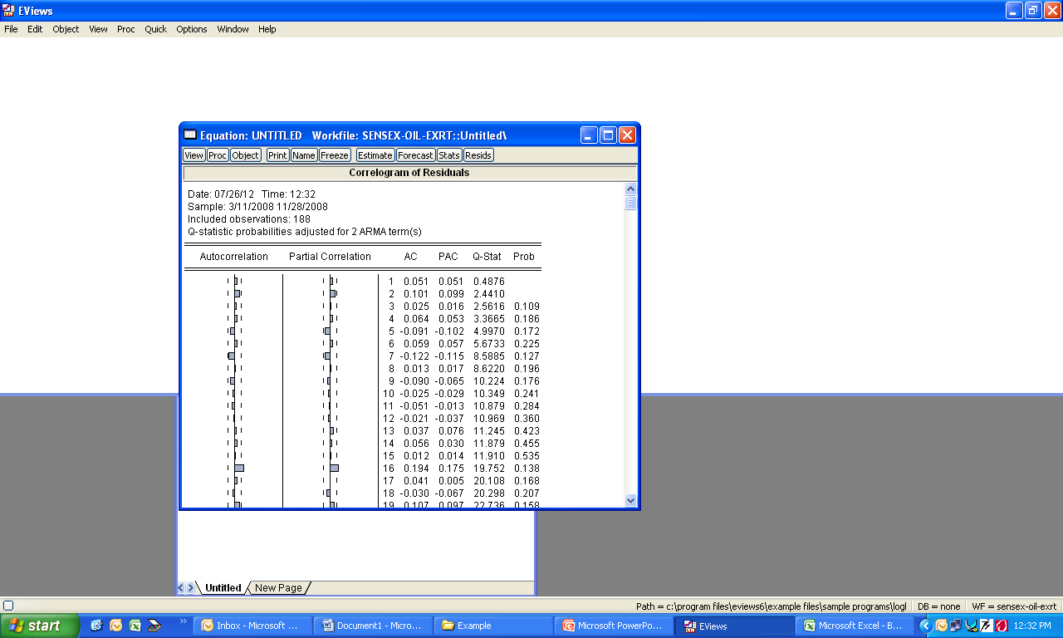

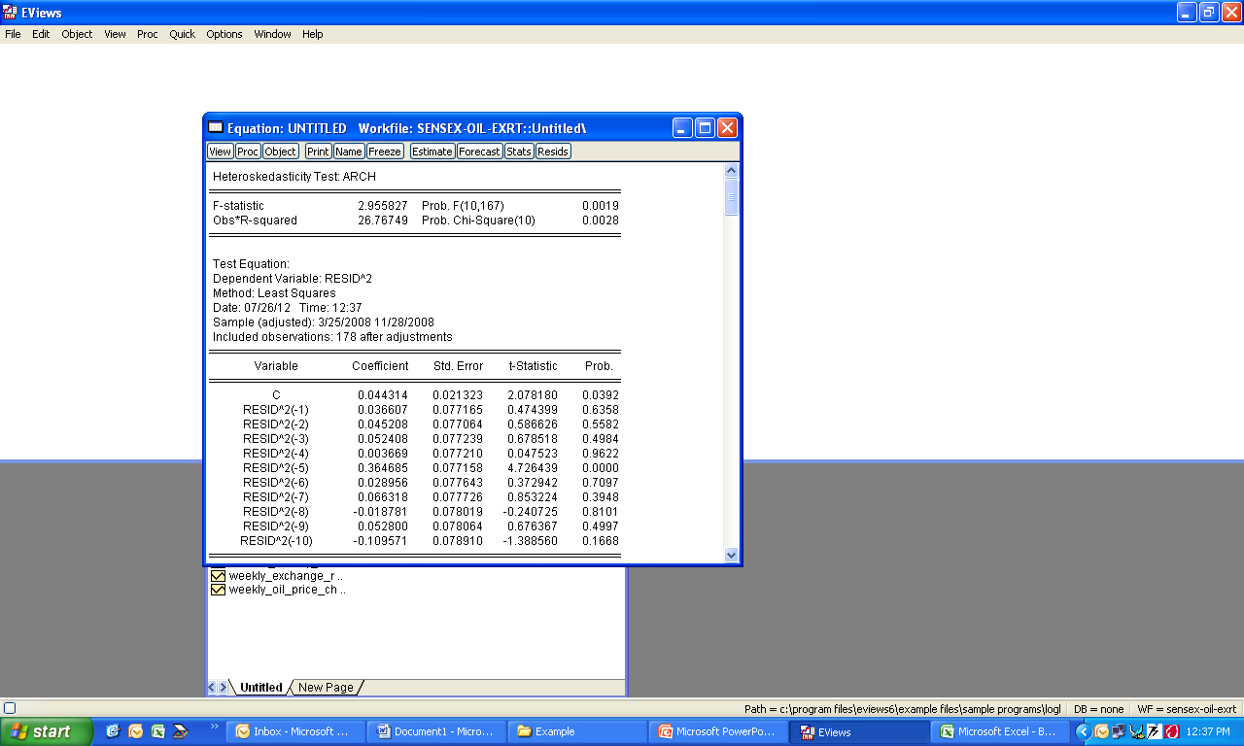
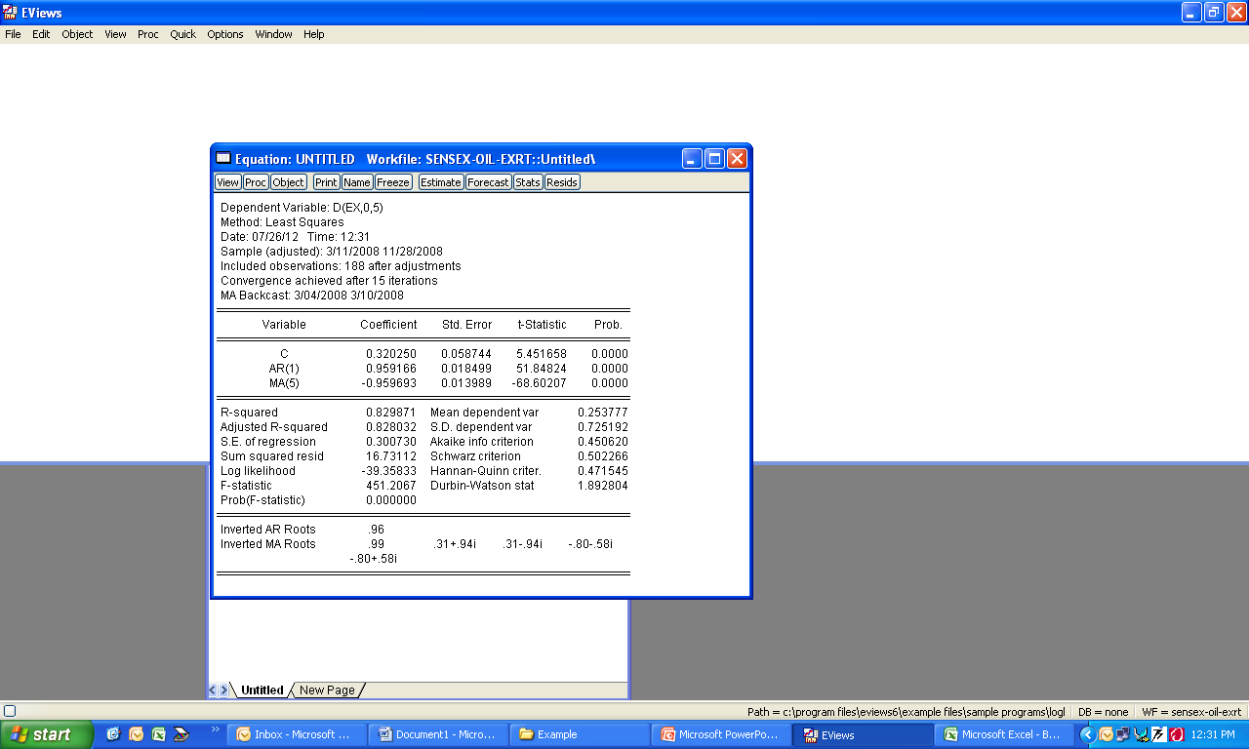
ARCH effect is present at higher lags.
Estimate ARCH model

Slide 69
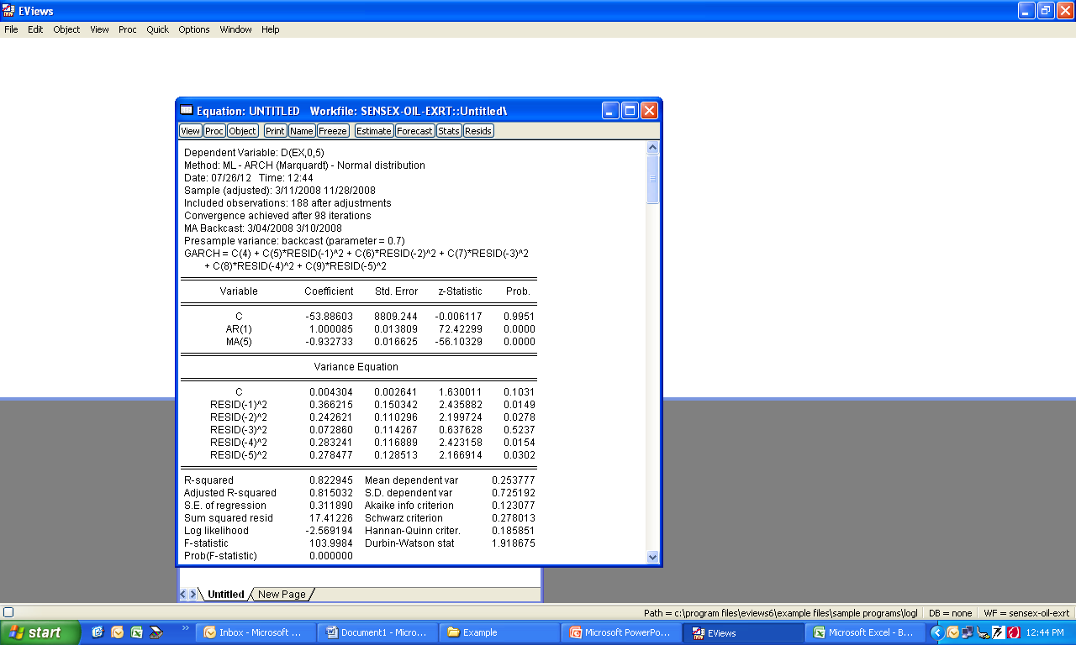
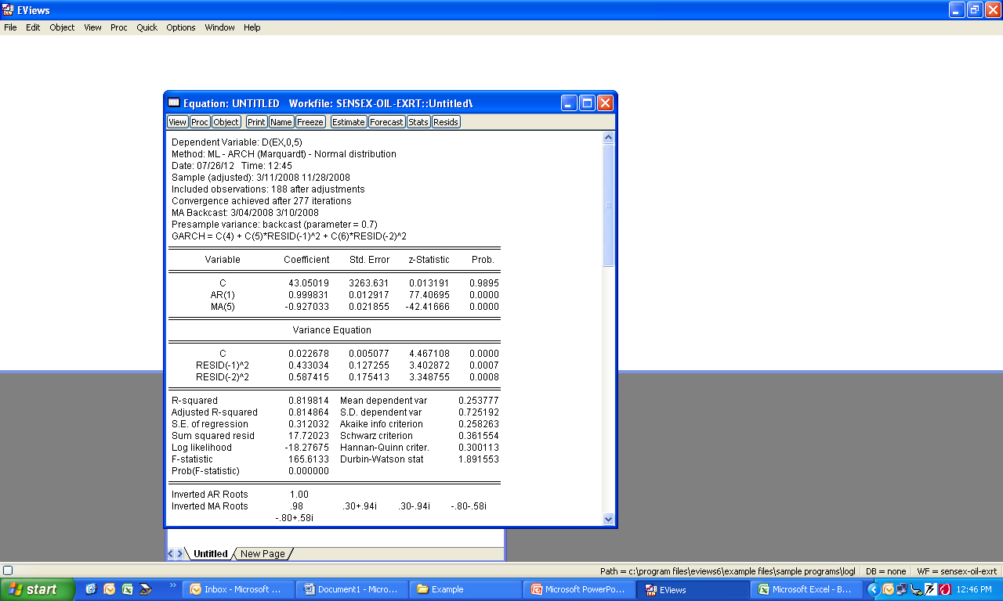
Higher order lags are significant.
Positive and less than 1
ARCH (2) .

Slide 70
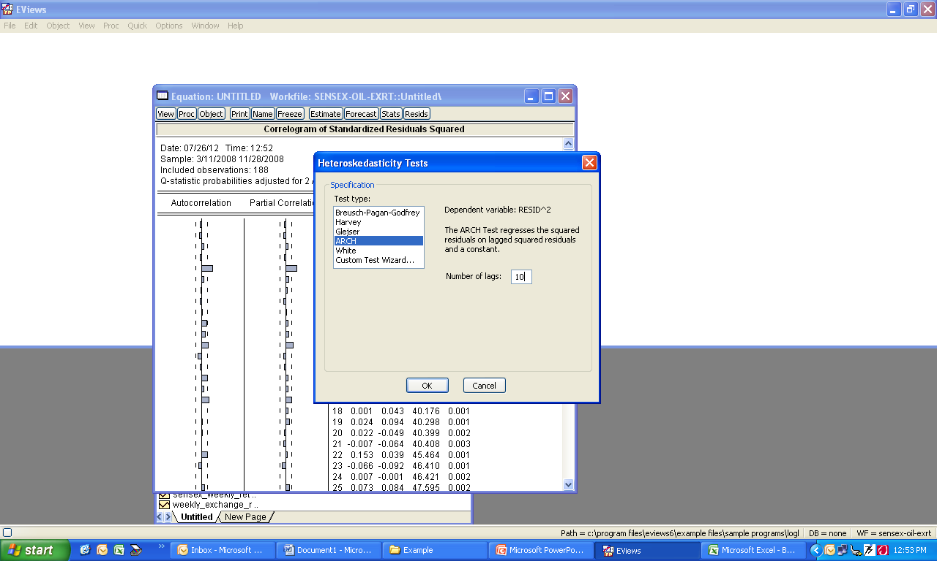
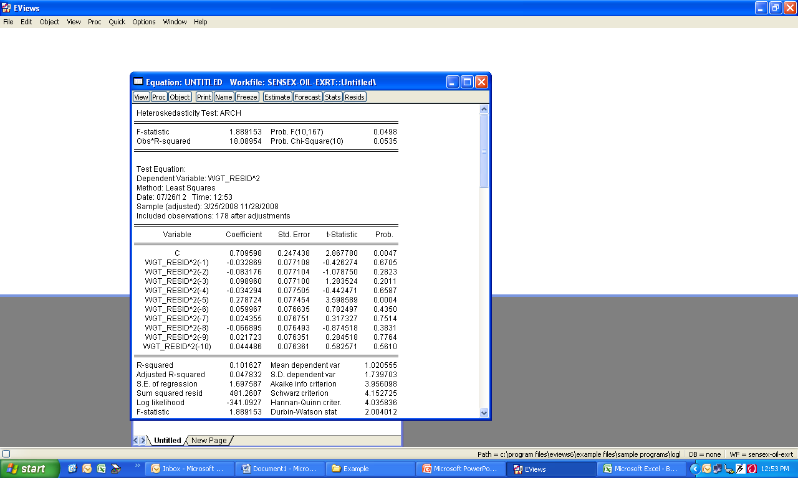
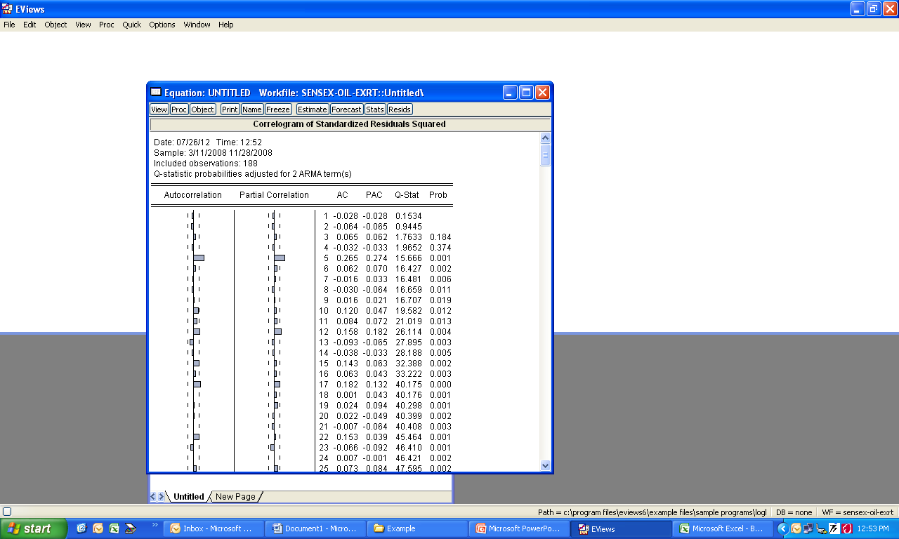
Volatility is still present

Slide 71
Forecast of
ARIMA (1,0,0) SARIMA(0,1,1)⁵ ARCH (2) Model
Suggests …ARCH(2) is not appropriate, other volatility models may be appropriate.
Forecast of
ARIMA (1,0,0) SARIMA(0,1,1)⁵ Model

Slide 72
CASE Modelling and forecasting of day-ahead Oil Price

Slide 73
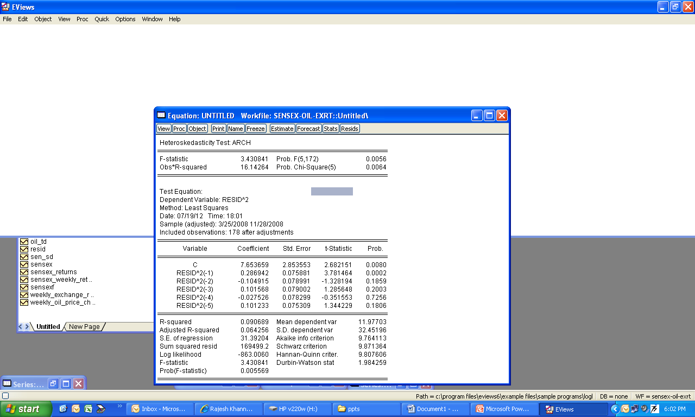
ARCH Test
ARCH effect is present

Slide 74
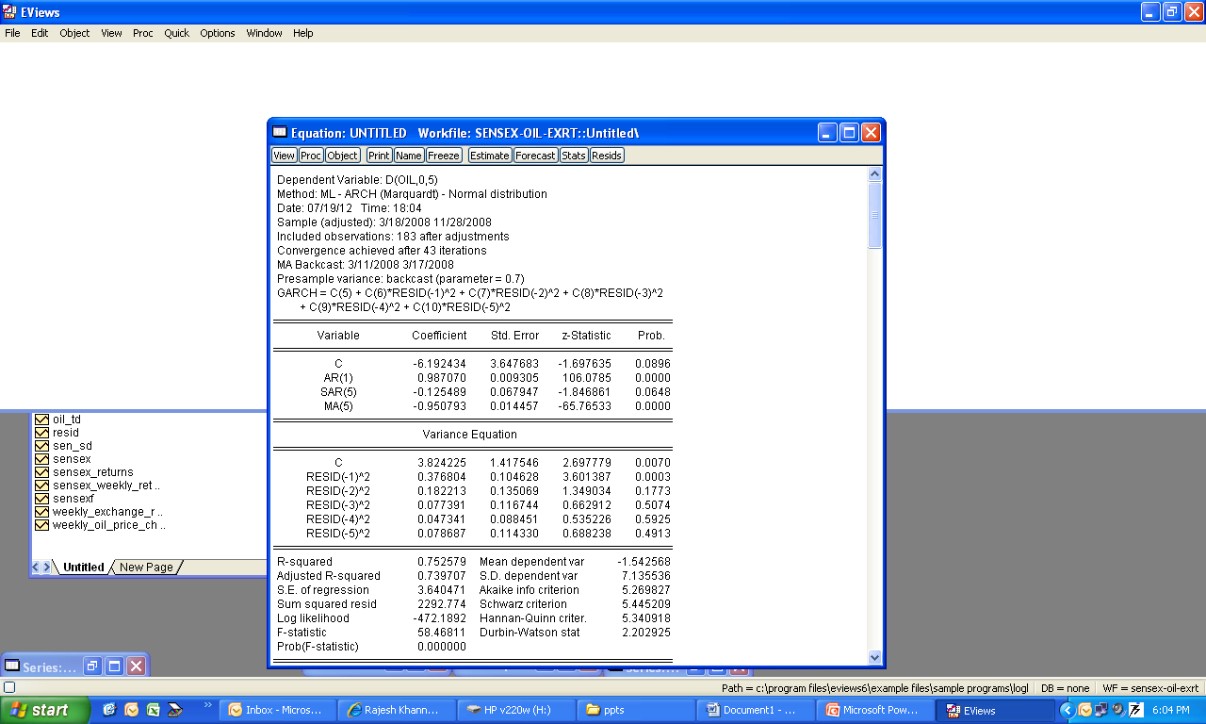
Estimate ARCH Model
Lower order ARCH parameters are significant.
ARCH(1) model gives better result.

Slide 75
CASE Examining crude oil price-exchange rate nexus for India during the period of extreme oil price volatility Published in Applied Energy (Elsevier Publication): Vol -88 : 2011 Author : Dr. Sajal Ghosh, Faculty at MDI, Gurgaon

Slide 76
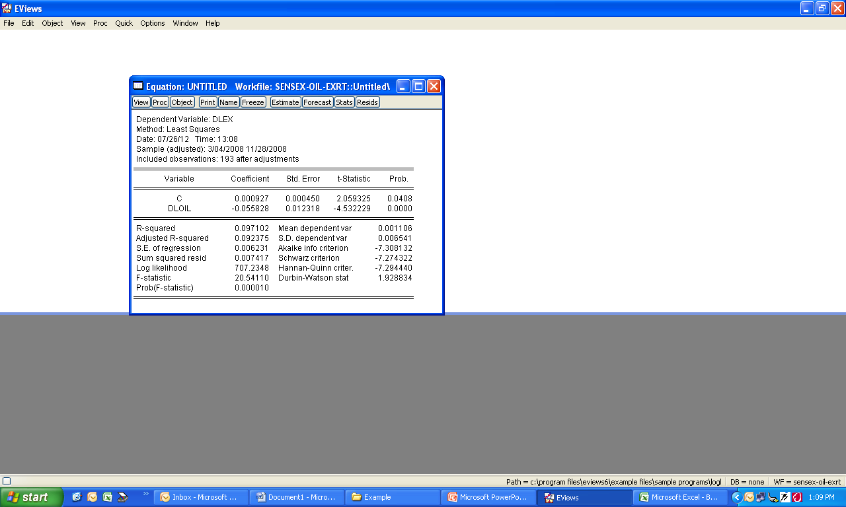
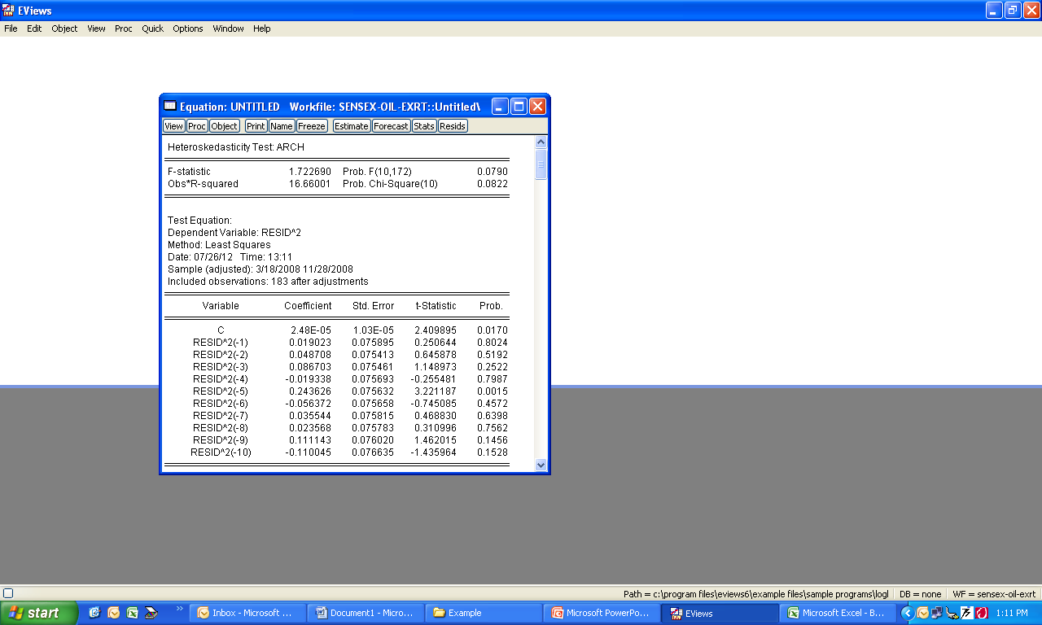
OLS regression of
Changes in exchanges rate as a function of changes in oil price
ARCH effect is present at higher lags….6,20,21, 30. Estimate ARCH model of higher lags. ARCH (6).
Test ARCH-LM test after running ARCH(6) model

Slide 77
GARCH Model CASES

Slide 78
CASE Modeling and forecasting of day-ahead electricity price in Indian Energy Exchange

Slide 79
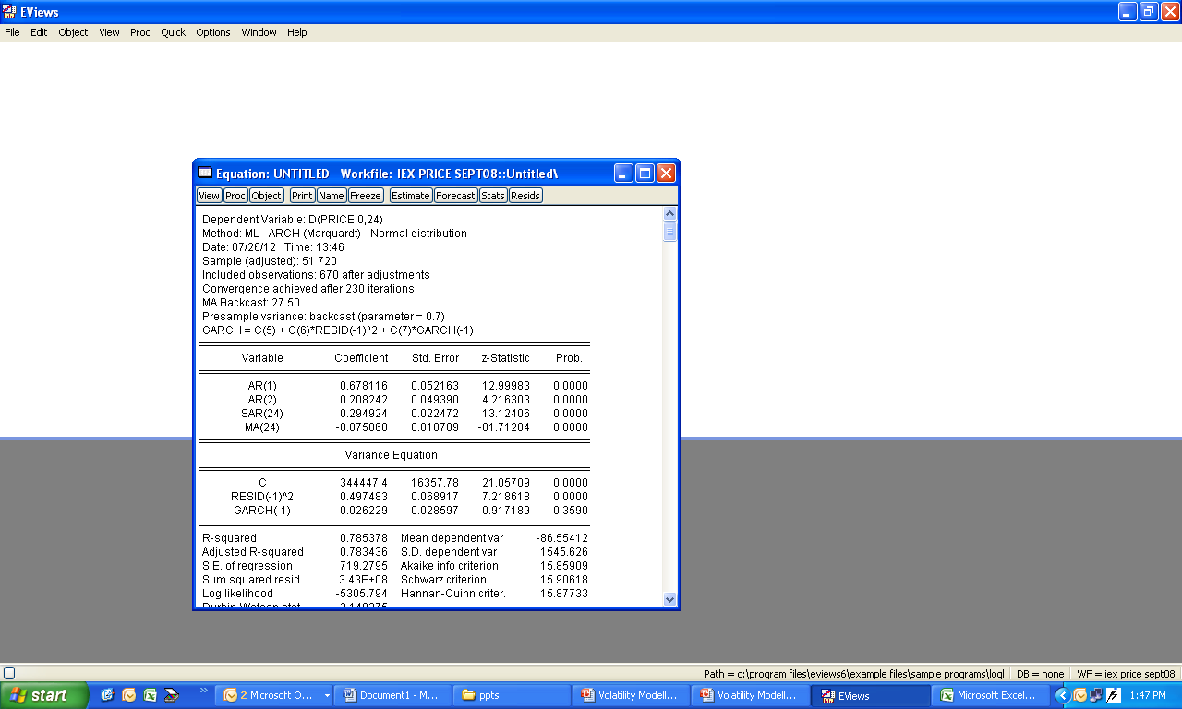
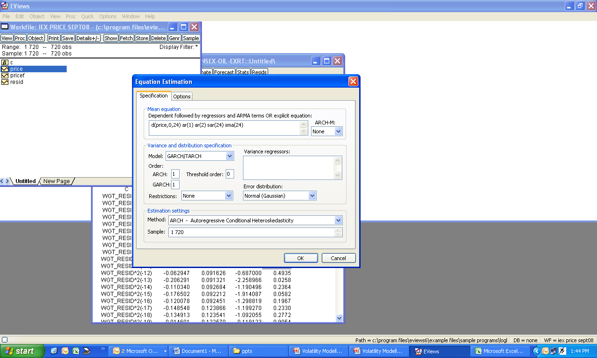
IEX Energy Price CASE GARCH(1,1)
Not an appropriate model
GARCH(1,1)

Slide 80
CASE Modeling and forecasting of day-ahead Exchange Rate

Slide 81
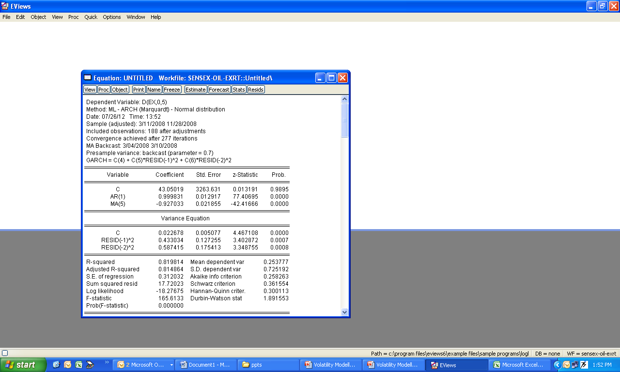
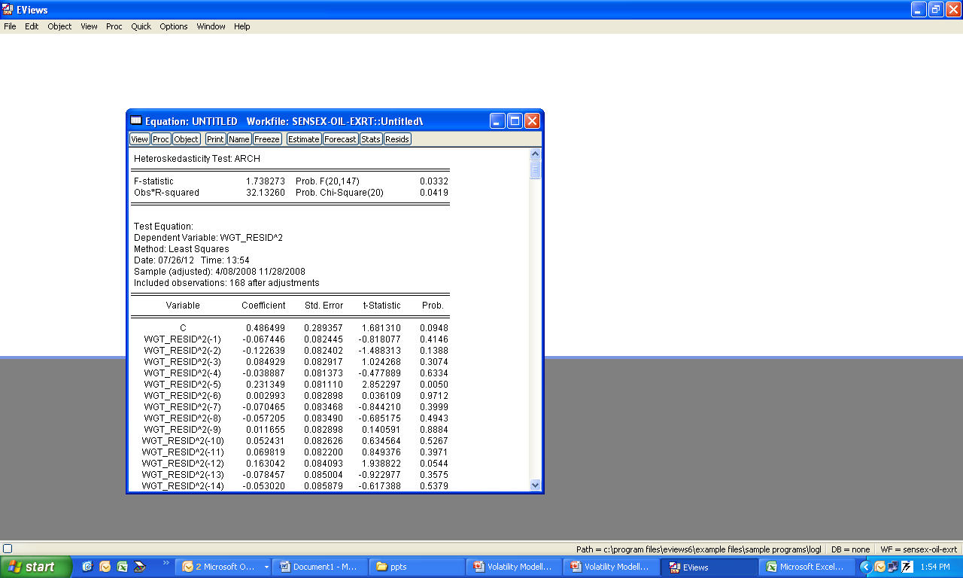
Exchange Rate Case
Volatility is still present

Slide 82


Variance of error has become homoscedastic

Slide 83
CASE Modelling and forecasting of day-ahead Oil Price

Slide 84
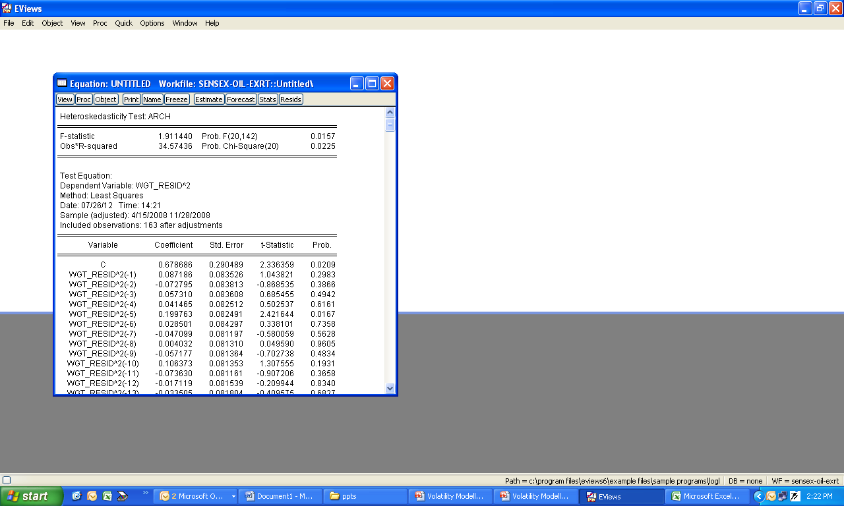
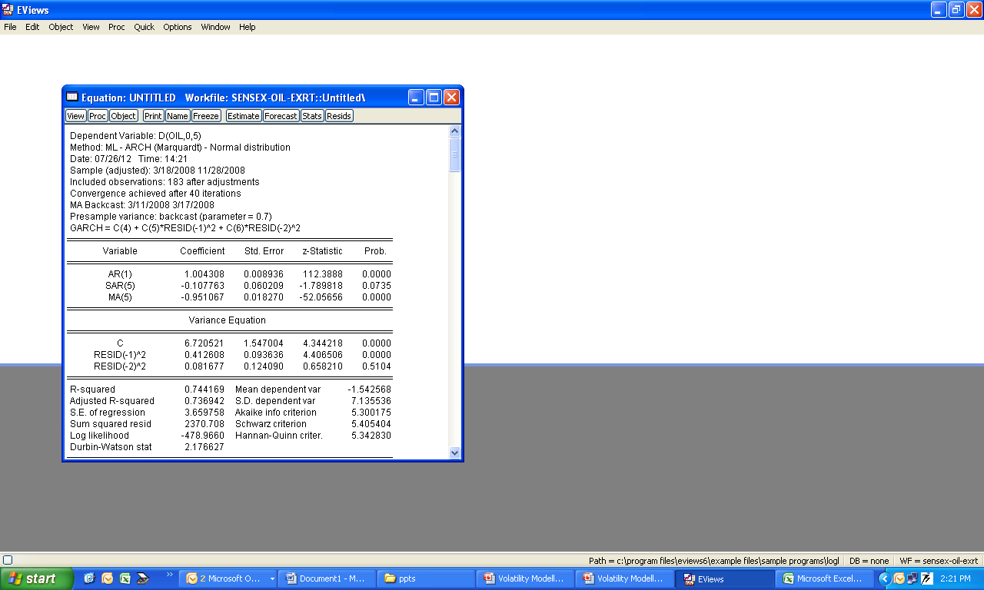
Volatility is present

Slide 85


Error variance has become homoscedastic

Slide 86
CASE Examining crude oil price-exchange rate nexus for India during the period of extreme oil price volatility Published in Applied Energy (Elsevier Publication): Vol -88 : 2011 Author : Dr. Sajal Ghosh, Faculty at MDI, Gurgaon

Slide 87
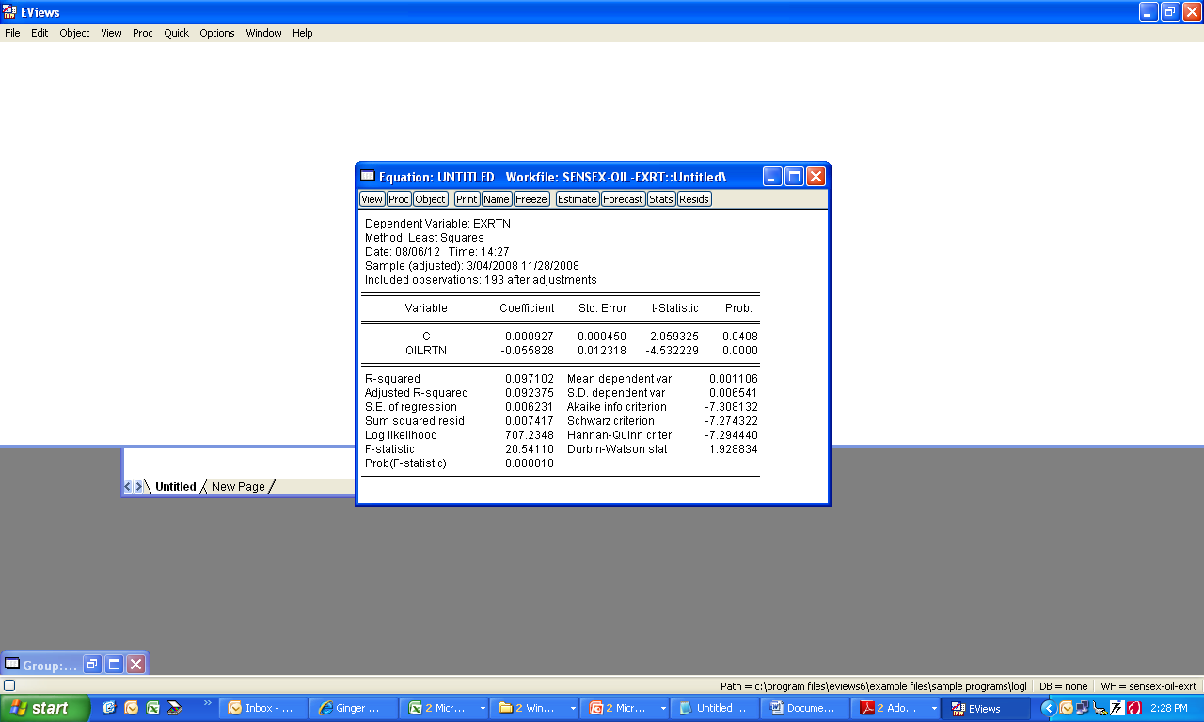
An 1% increase in oil price return, will result 0.05% or 5 BP decline in exchange rate of 5 BP depreciation

Slide 88
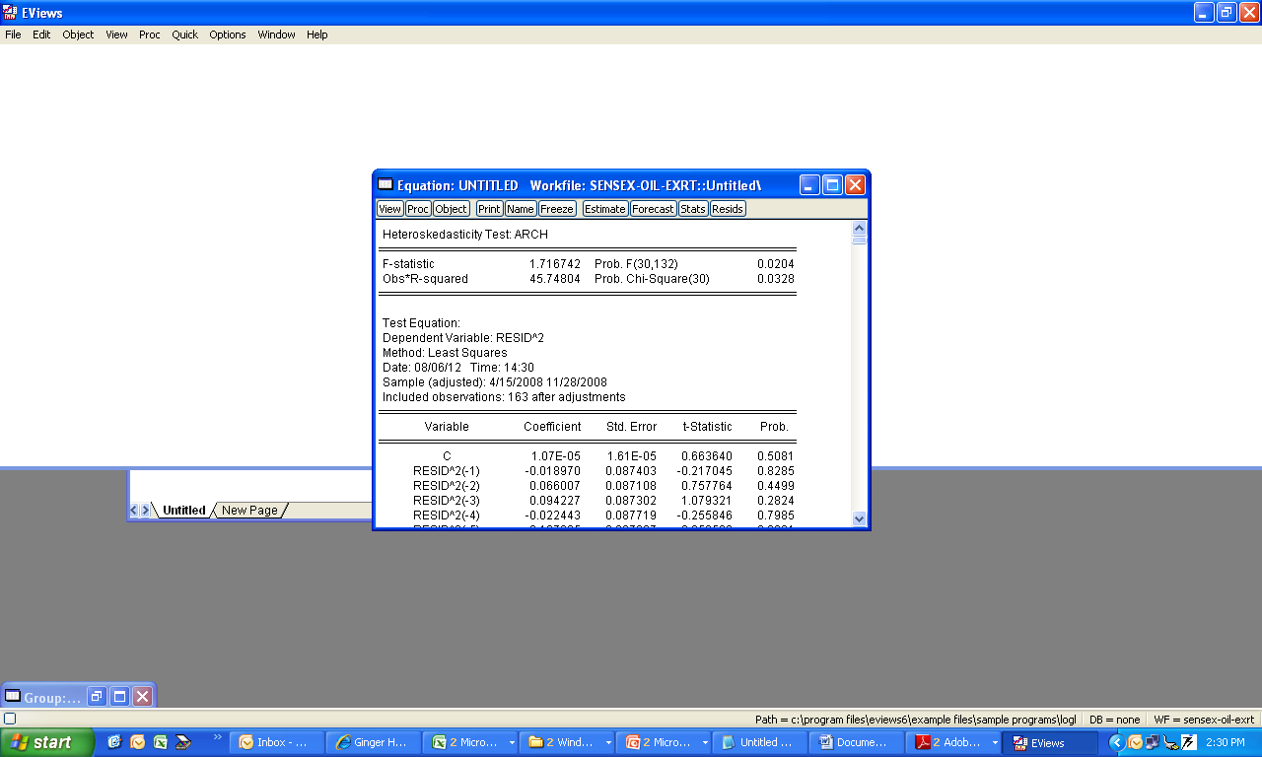
ARCH effect is present, so requires volatility modelling

Slide 89
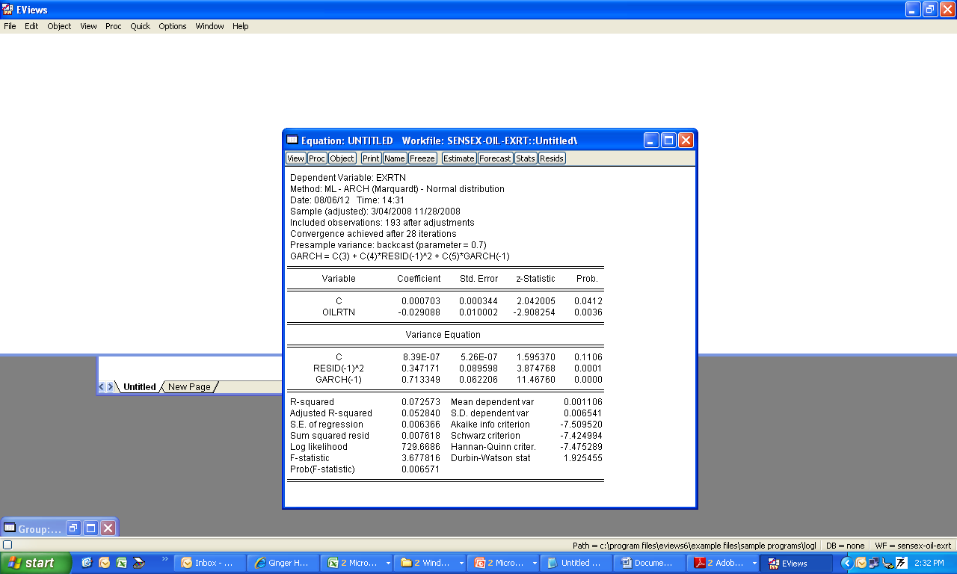
GARCH (1,1) Model

Slide 90

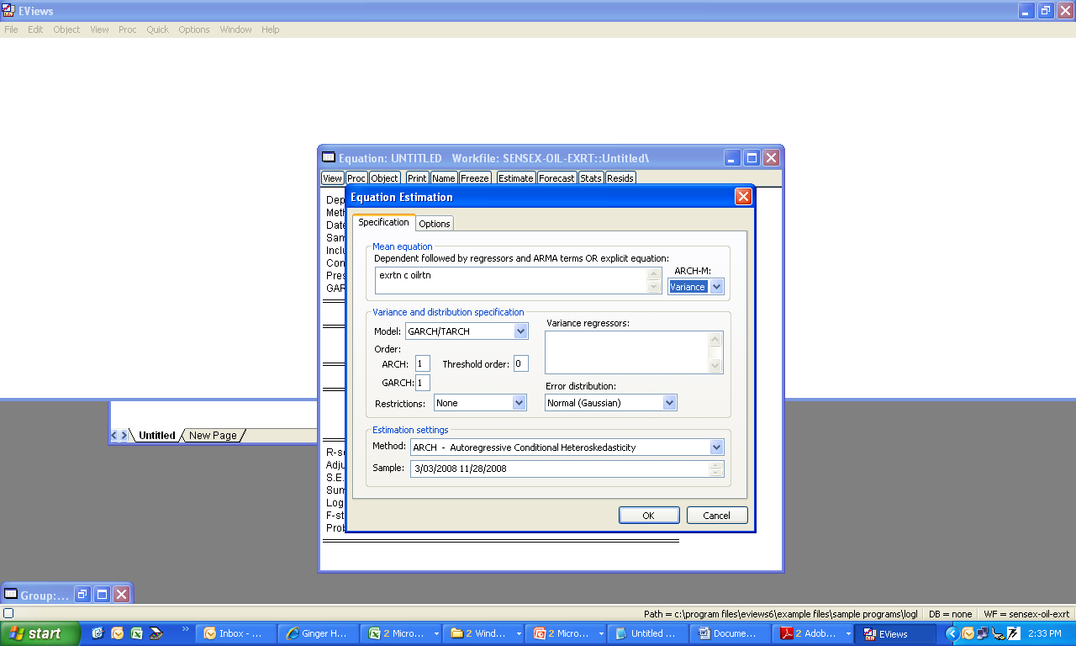
GARCH-M (1,1) Model. Exchange Rate Return is not a function of its volatility or its own risk
Select Variance

Slide 91
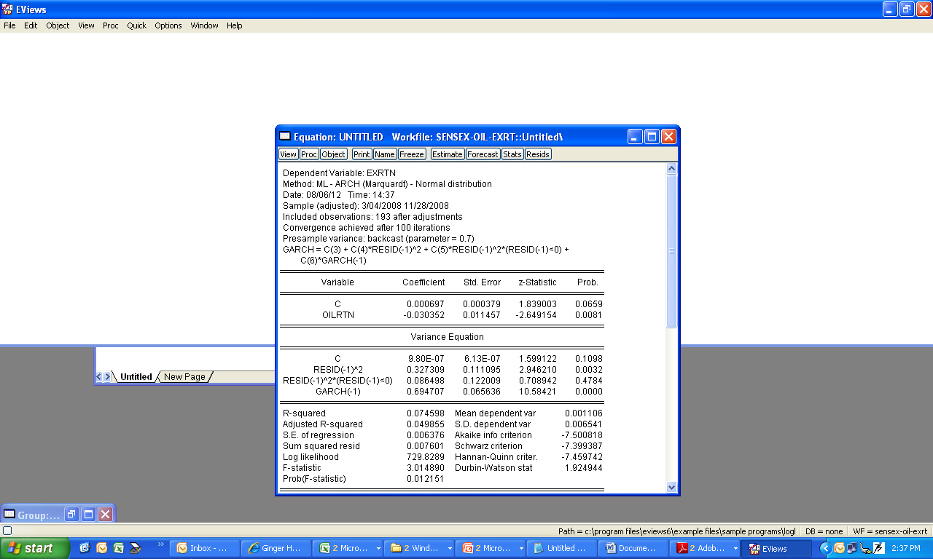

TGARCH (1,1) Model. There is no asymmetric effect in exchange rate return when there is a shock in the market or the effect of positive or negative shock has similar effect in magnitude in exchange rate volatility in India
TGARCH (1,1) Model. Select 1 as threshold order

Slide 92
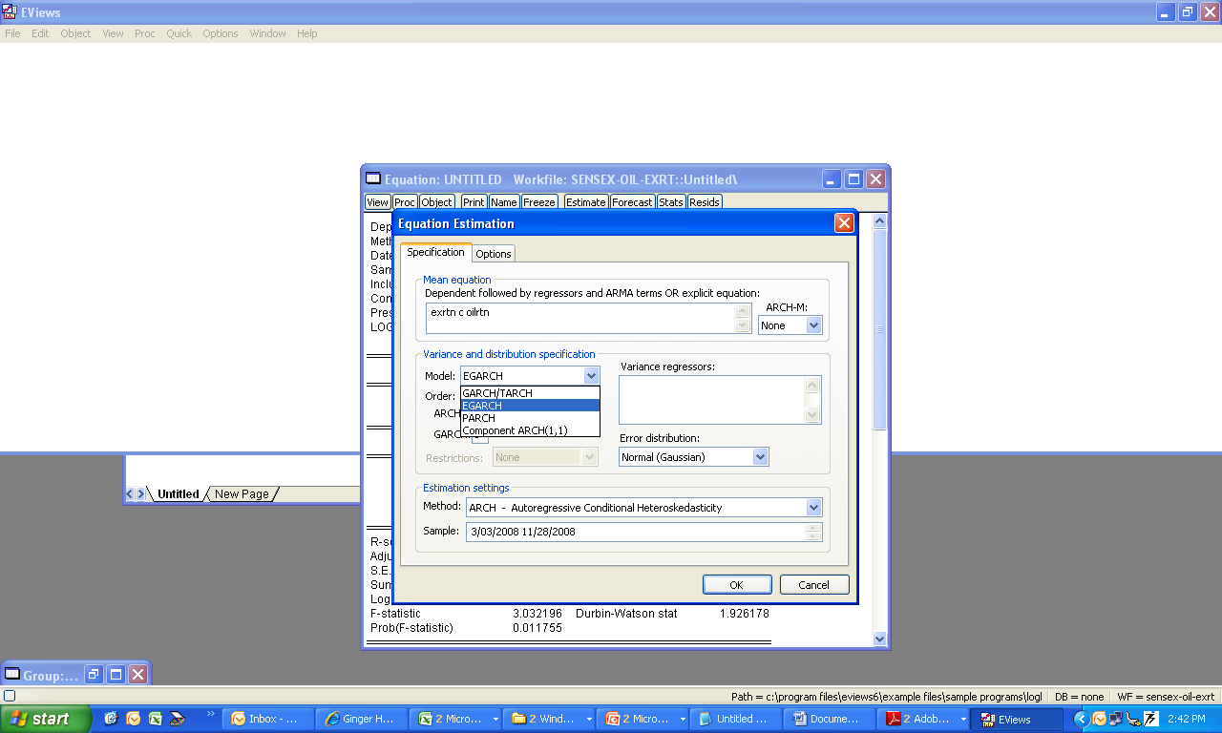
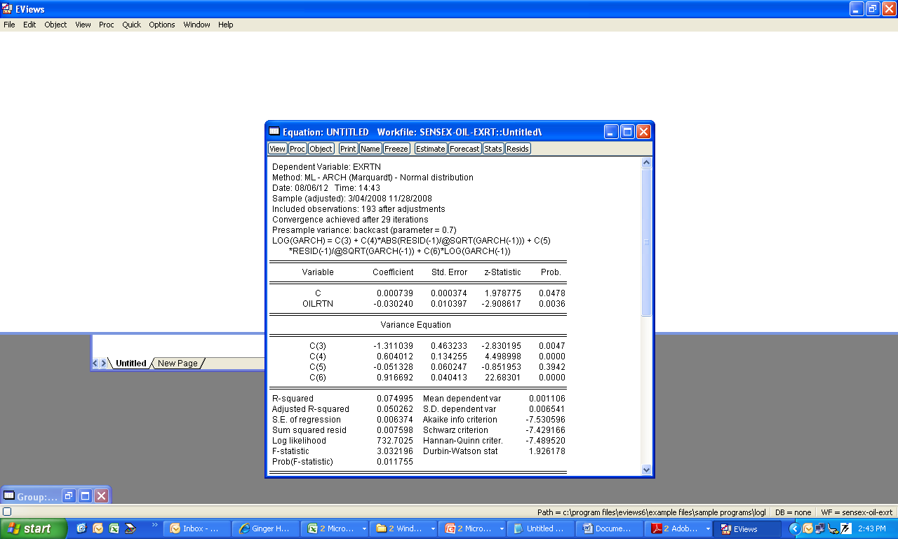
EGARCH (1,1) Model. The coefficient to measure asymmetric effect is insignificant.
Select EGARCH (1,1) Model

Slide 93
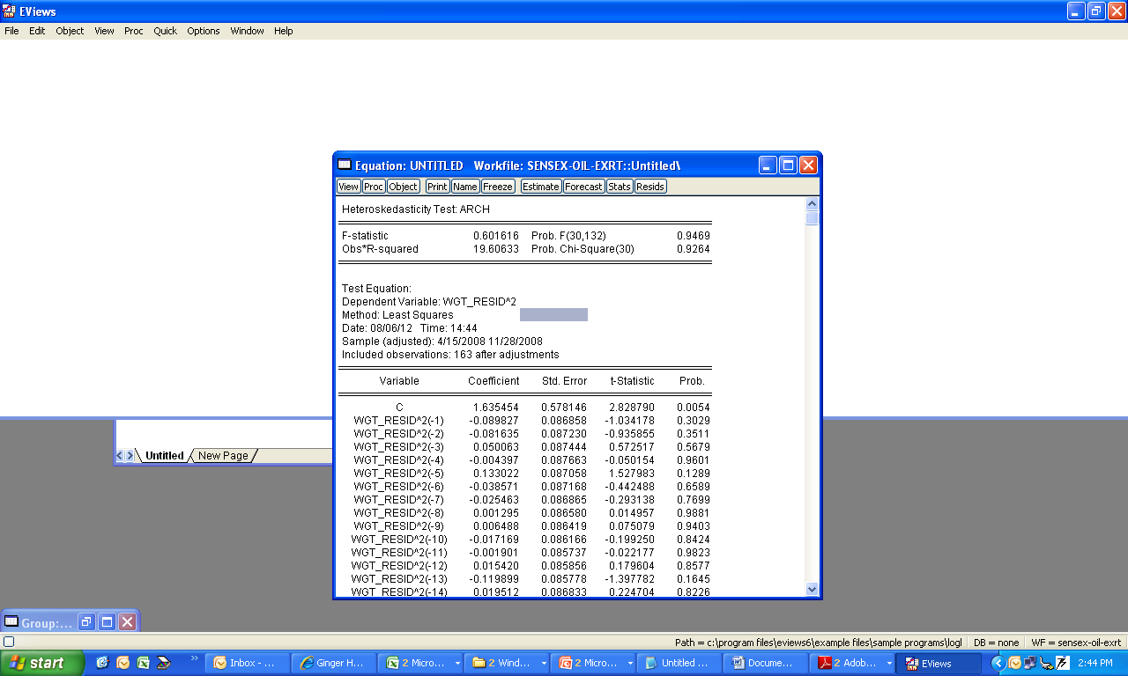
The error variance has become homoscedastic

Slide 94
CASE Modeling and forecasting of day-ahead Sensex
GARCH (1,1), GARCH-M(1,1), EGARCH (1,1), TGARCH(1,1)

